Slide 1
Farm Ranch Stress Assistance Network HDOA-CTAHR Seeds of Wellbeing Survey
Notes:
7,000 farmers in Hawaii
Tell a story of how our brain/mind is a prediction machine that optimizes resources/body budget. How then can we support capitalization rate (social-emotional resources0 & body budget for farmers.
Behavioral economists – Tversky & Kahenman, prospect theory, risk aversion – they won nobel prize because they took utility theory one step further by incorporating the reference point, and highlighting how perception is completely context dependent. The choices we exercise/risk vs. loss decisions depend on reference of where we are coming from.
Highly stress profession requires farmers and their families to be highly adaptable and resilient in the face of uncertainty
Stressor - ‘chemical or biological agent, environmental condition, stimulus, or event that triggers stress in an organism. Reaction to that stress is referred to as ‘fight or flight” response.
Farm stress is the ‘stress experienced by farmers and their families as a result of the unique agricultural work environs”
Internalities, Typical stressors:
Constant responsbilities - off-farm employment to support farm and family..increased weariness and loneliness. Rurality - separation from others, Loneliness is a HUGE risk factor
Location - farm both place of living and earning income
Multigenerations - family dynamics and conflict
Access, affordability, and acceptance (stigma) to resources
Externalities,
Weather
Market prices/tariffs
debt/cash flow
Health care costs
Reducing stigma is a major desire: 87% farmers/farm workers say it is important to reduce stigma about mental health in ag community
Main obstacles for seeking help/treatment: cost, availability, accessibility, stigma, embarassment
Percentage of farmers/farmworkers who thinks social isolation impacts farmer’s mental health increased 22% since April 2019
Janna Imel 2019 Dissertation (Virginia Commonwealth): over last century, farming has shifted away from community task to a task individual to the farmer and family. Changes in social structure have reduced opportunities for social engagement and coping mechanisms once anchored in the social support of the farming village (Donham & Thelin, 2016). the actual act of farming today is more
independent and isolating due to changes in crop production (e.g., specializing in one crop versus
raising small amounts of various crops, and needing to increase crop production to make a profit)
and increases in technology (e.g., equipment to help with gathering crops versus needing the help
of community members to gather crops; Donham & Thelin, 2016).
In problem-focused coping, the individual attempts to modify the
problem, often resulting in the creation of problem-solving strategies and working to solve the
problem causing stress (Lazarus & Folkman, 1984). E.g., changing the equipment break, leaks). emotion-focused coping centers
on the individual working to manage emotional distress resulting from the stressor (Lazarus &
Folkman, 1984). Emotion-focused coping is frequently used in situations where a stressor cannot
be eliminated (e.g., the death of a friend; Hovey & Seligman, 2006). stressors that they cannot fix, but must
endure (e.g., droughts, changes in commodity prices, the death of livestock, and the loss of a
crop, etc.). If farmers try to apply problem-focused coping strategies
to uncontrollable external stressors (e.g., government regulations and economic changes), they
can end up feeling powerless and experience learned helplessness, which can increase anxious
and depressive symptoms (Lefcourt & Martin, 1983). Emotion-focused coping can take on many forms including reaching out to social support
networks, reinterpreting events in a positive light, focusing on and venting of the emotions
associated with the stressor, denial, acceptance, and using religion (Baker & Berenbaum, 2007;
Carver, Scheier, & Weintraub, 1989). Above all, farmers across the board in coping studies consistently mention using their
social support network to cope with stressors. However, with the changing landscape of rural
areas and farm families (e.g., rural population increasingly moving to cities) farmers may see a
loss of in-person social networking and need to adopt other ways of coping. Although coping
strategies used by farmers in response to stress have been investigated, the research was
conducted decades ago and may not apply to the current cohort of aging and older farmers (i.e.,
baby-boomer generation). this study explored
dispositional mindfulness as a potential coping mechanism for farmers, which can be applied by
an individual when social support is unavailable.
State mindfulness vs. trait mindfulness
dispositionally mindful person
confronts the stressful situation with curiosity and openness, overriding the mind’s tendency to
make quick judgments (Garland, Gaylord, & Fredrickson, 2011). Individuals higher in
dispositional mindfulness are more apt to draw their attention to the present without ruminating
on past or future events (Brown & Ryan, 2003).
dispositional mindfulness may have the ability to empower farmers in the face of
uncontrollable stressors by providing more cognitive flexibility and allowing farmers to decenter
from negative thoughts that automatically arise out of stressful situations.
Per Garland et al. (2011),
“Mindfulness and reappraisal may be linchpins of resilience, unlocking the basic human
potential to thrive amidst the unrelenting demands of living” (p. 8). Dispositional mindfulness
shows potential as a tool for farmers to help them thrive in even one of the most demanding and
challenging professions that is also inseparable from their lives.
Perceived control is adaptive mechanism linked to better self-regulation and wellbeing, but only in situations where it’s controllable
For example,
when farm stress is considered solely as an individual problem and not in the context of
pressures from outside forces, the farmer tends to internalize the stress, take blame for their
current predicament, and can feel guilty for not “succeeding” (Kubik & Moore, 2003).Although a farming “failure” (e.g., loss of a crop,
not having help to run the farm, not having enough cash or capital for the farm, or not being
assured of the farm’s future, etc.) seems incredibly personal to the farmer, the reality is that
aspects of the “failure” are also linked to economic, political, and social factors, yet the farmer is
often internalizing the majority of the responsibility (Kubik & Moore, 2003).
the new farm bill, “The
Agriculture Improvement Act of 2018,” promises to provide Federal funds for behavioral and
mental health resources in farming communities.
Striking difference between visits to doctors for physical concerns (74%) vs. mental/emotional concers (31%). Stigma asking for help

Slide 2
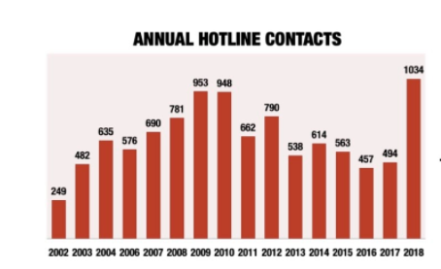
Context: Farmer’s Mental Health on the Mainland
Depression 4.5 higher than U.S. average (Imel, 2019; Ringgenburg et al., 2018)
Suicide outnumbered homicide rates
During 2018 farm crisis & Covid-19, issue is looming large

Slide 3
Context: What about for Hawaii?
Absence of data on farmer’s mental health, yet economic trends suggest increasing financial stress (La Croix & Mak, 2021)
CTAHR Extension’s covid-19 impact survey in 2020 with 388 ag producers
One item asked about perception of stress due to covid-19 (see next slide)

Slide 4
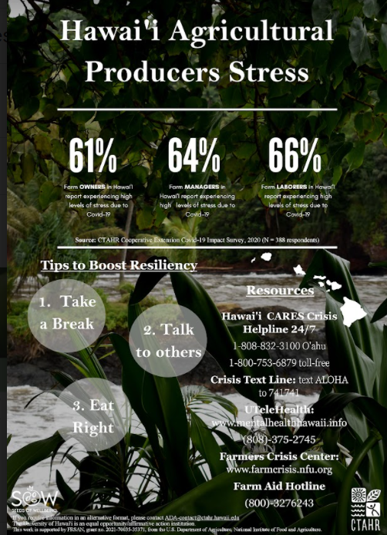

Slide 5
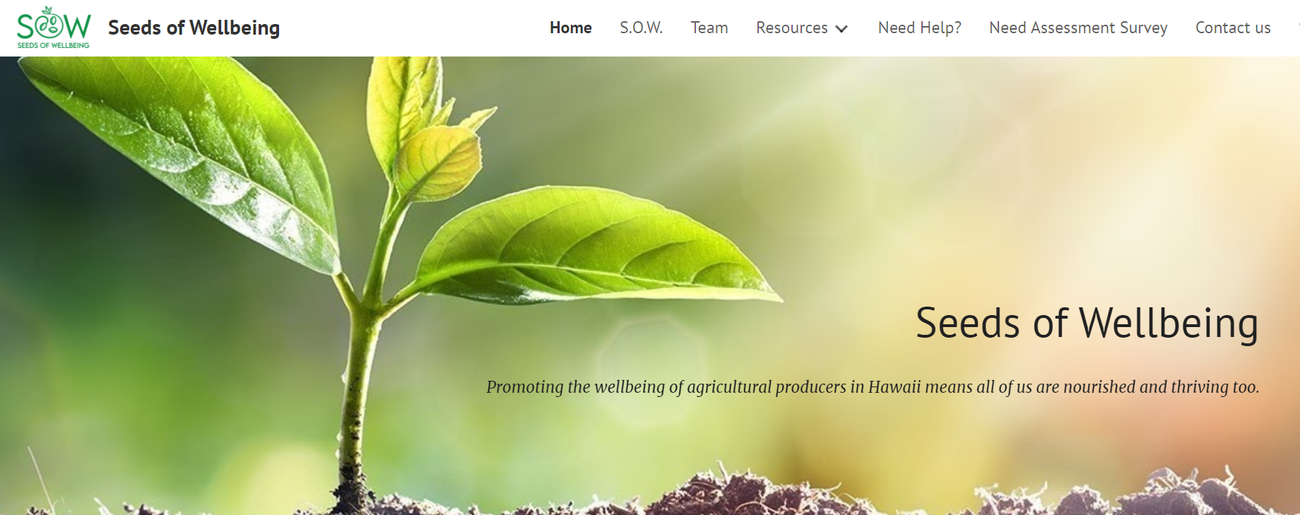
FRSAN Project in Hawaii: Seeds of Wellbeing https://sites.google.com/Hawaii.edu/sowwell/home)

Slide 6
Seeds of Wellbeing Needs Assessment
Goal: Understand the stressors, coping, resiliency, of Hawai’i Ag Producers, and what they want for resources
How?
Survey: Input from Primary Ag Producer & Family Members/`Ohana
Currently available online
Note: results of mainland’s needs assessment (very, very low response rate); Hawaii can be the exemplary, model state, & can lead the way on this!
Interview, can be conducted…
Phone
Zoom
In-Person
Why is this important?
The responses will determine what we develop & offer
Allow us to map & understand relationship between stress & health outcomes for Hawaii’s ag producers => gives us ammunition to advocate for more resources to farmers!

Slide 7
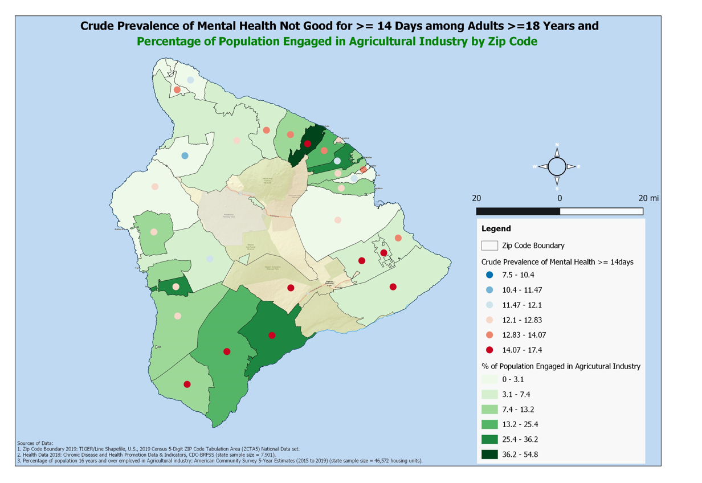
Example: Mapping

Slide 8
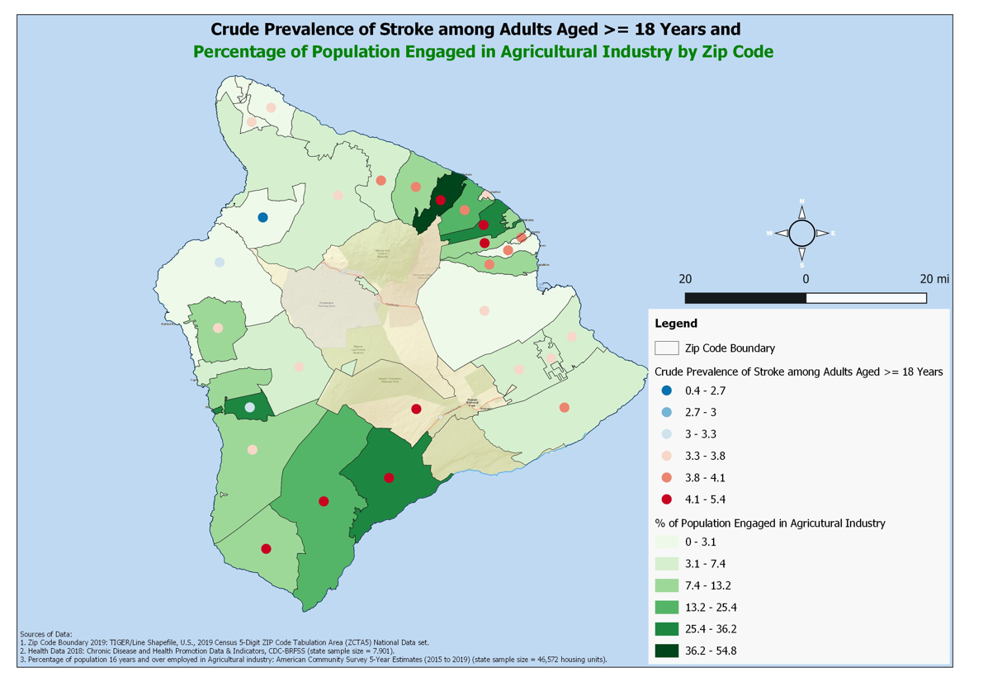
Example: Mapping

Slide 9
Primary Ag Producer & `Ohana Survey
Available in 7 languages (English, Chuukese, Chinese, Ilokano, Spanish, Thai, Vietnamese)
10-15 minutes
Anonymous & Confidential
Demographics
Age, Gender, Marital Status, Educational Level, Insurance Status, Residence County/Zip Code, Ethnicity

Slide 10
Primary Ag Producer & `Ohana Survey
Agricultural Industry & Role
Years in industry
Acreage (select categories)
Gross revenue (broad categories)
Stress & Health Questionnaire
What stresses you?
How do you cope?
What is your preference for service/support topics
What is your preference for delivery of service/support topics

Slide 11
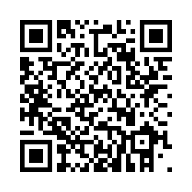
Please take next 10 minutes to scan this QR code, or copy & paste this link to complete the survey
https:tahr.qualtrics.com/jfe/form/SV_23Psq5DWbUP43SC

Slide 12
Recruitment Flyers, available in 7 languages too

