Slide 1
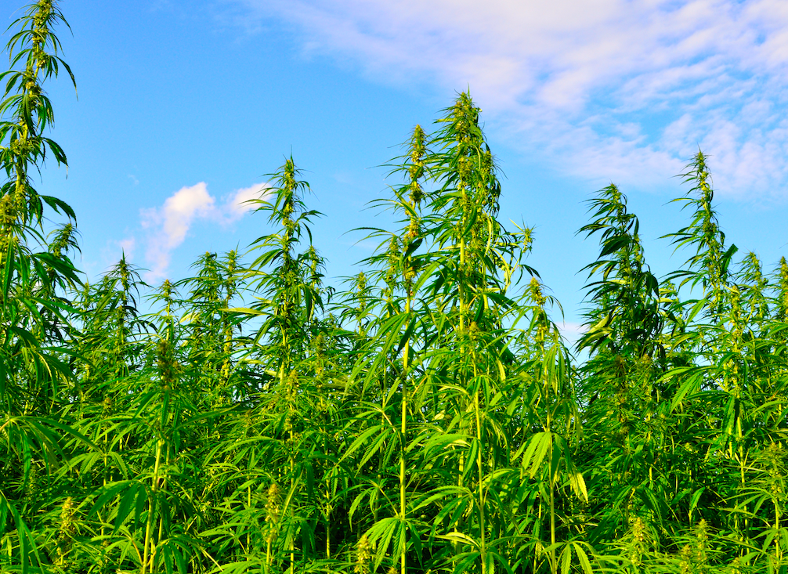
Hawaii Hemp Farmers Association hawaiihempfarmersassociation.org email: info@hawaiihempfarmersassociation.org or hhfu.bod@gmail.com

Slide 2
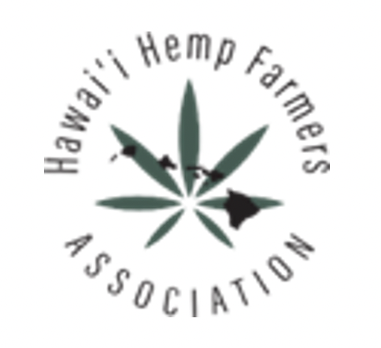
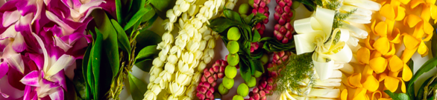
501(c)(3) Nonprofit organization founded to further the multi-faceted hemp industry in Hawaii and advocate for the needs of the industry, especially farmers.

Slide 3
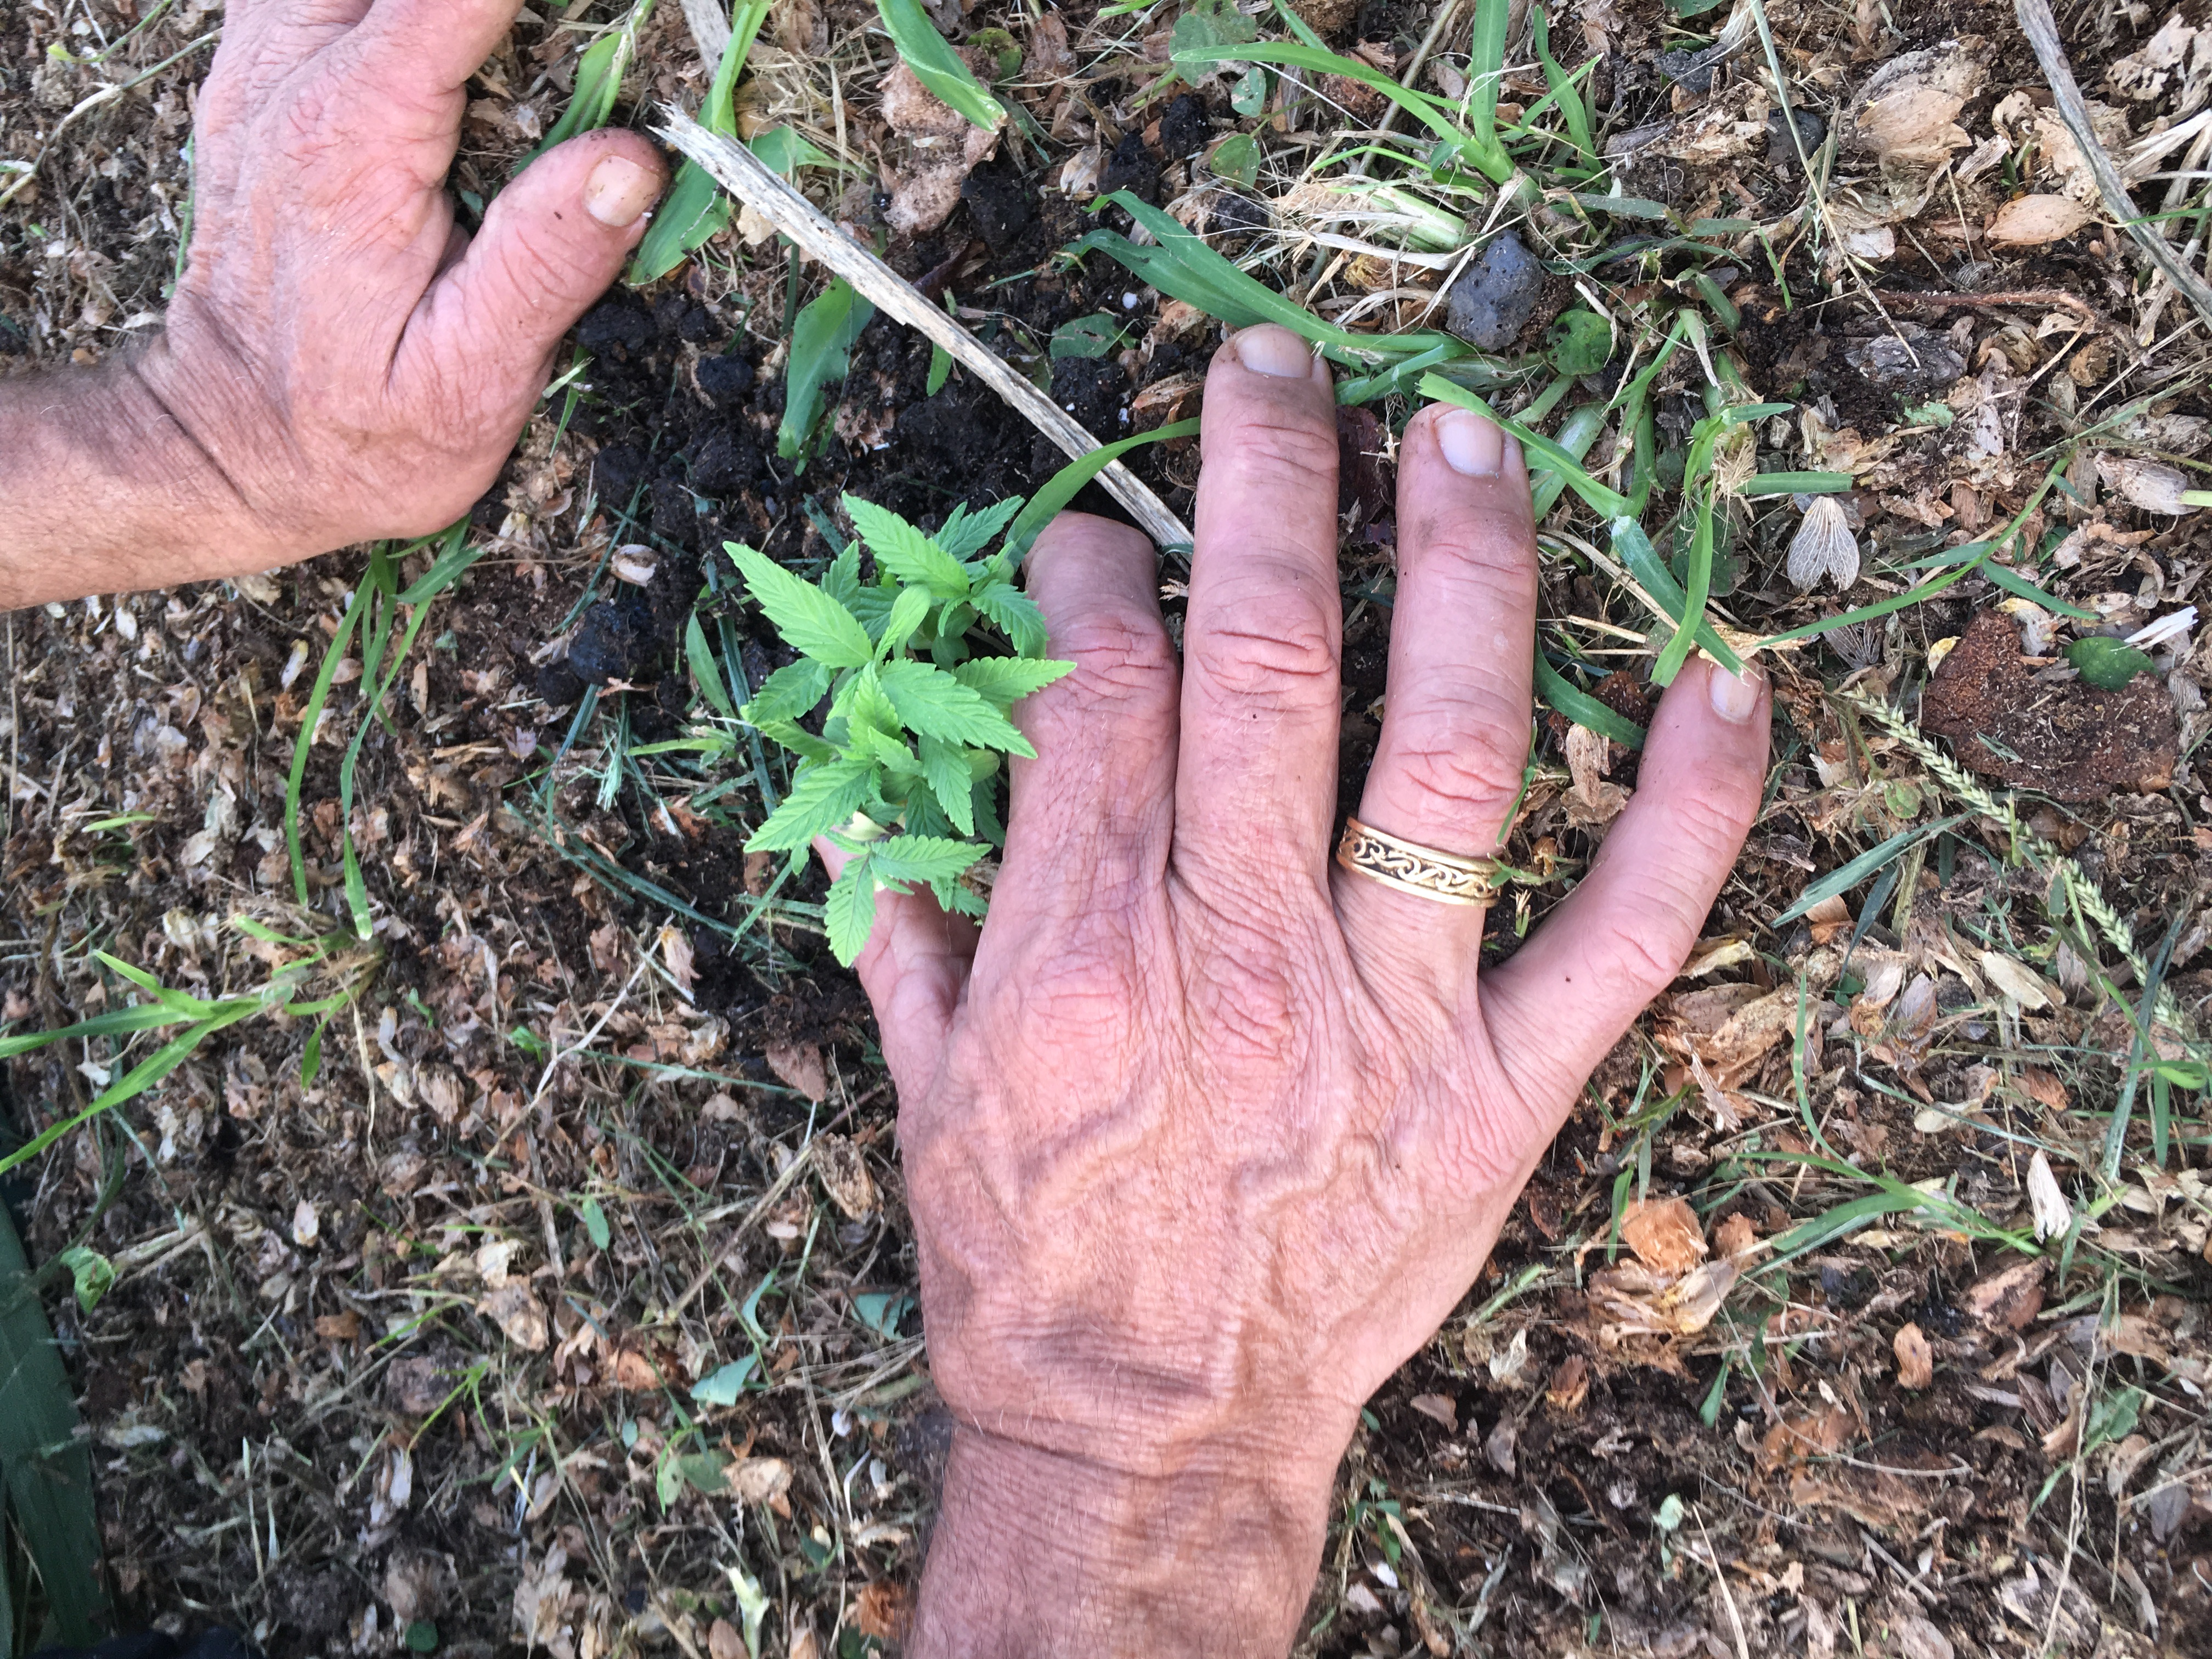
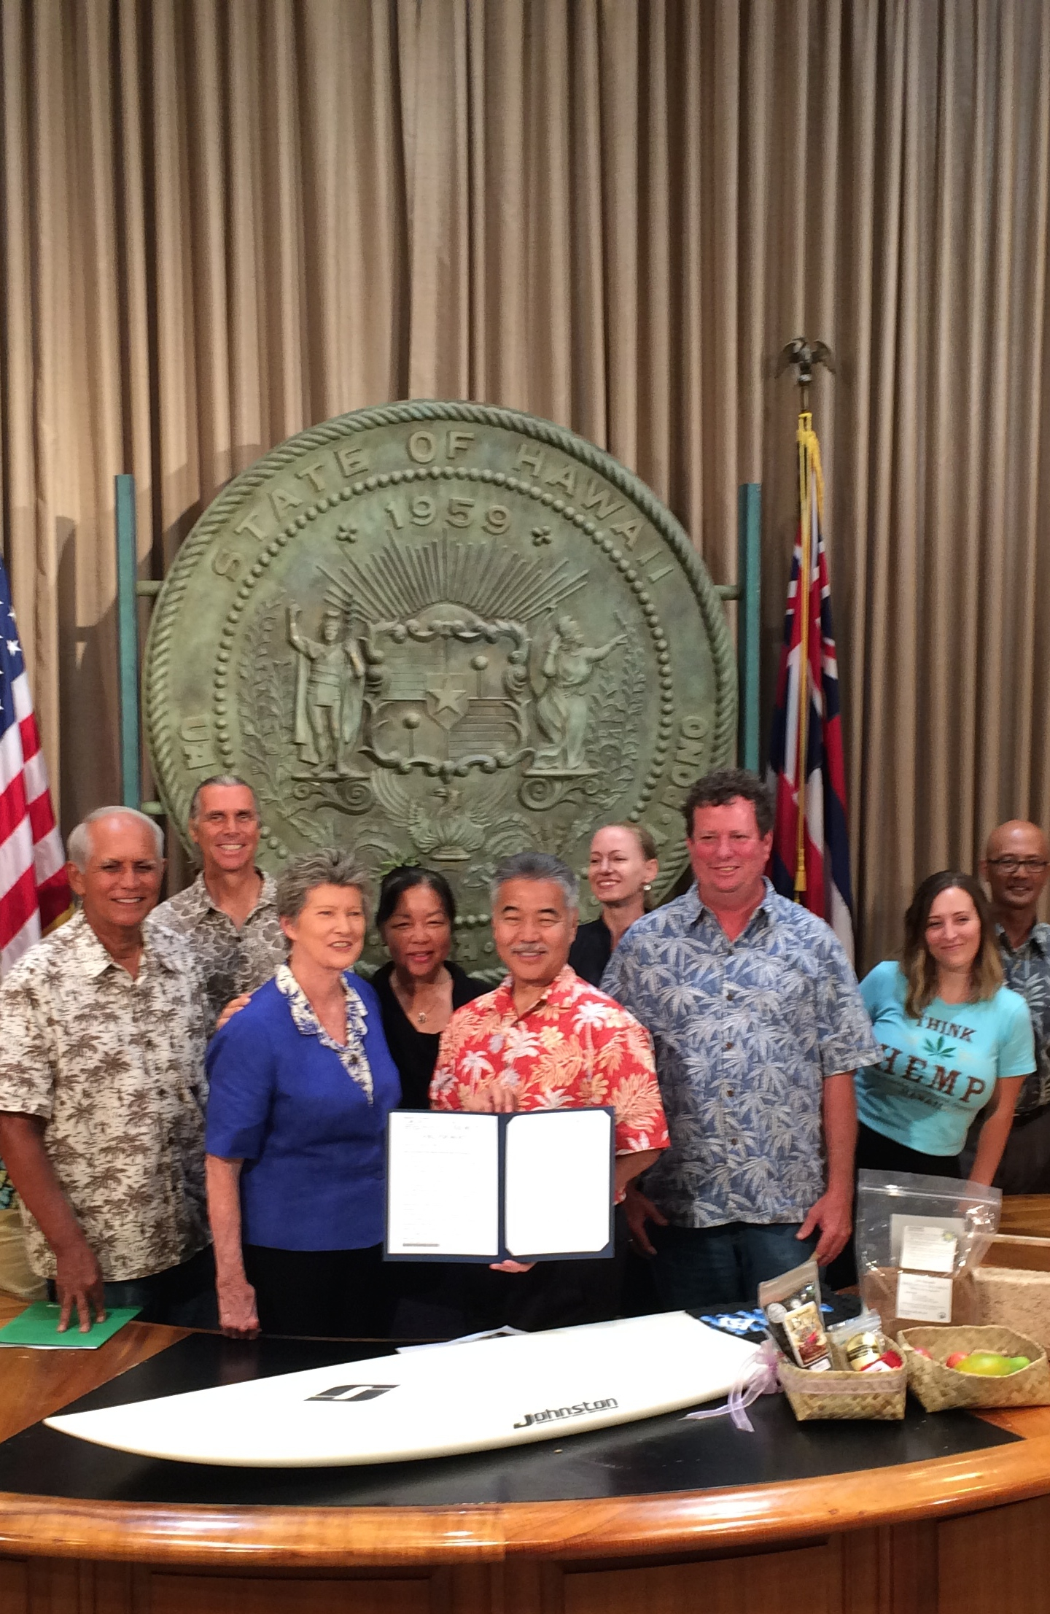
Hemp in Hawaii
Grown during whaling times for sails and rope
1992 Hawaii Hemp Council founded by Hawaii Island Farmers as ag and economic alternative to sugar cane – Clarence Baber co-founder
2000 Hemp pilot study authorized by Hawaii State Legislature but abandoned
2013 – 2015 Farmers coordinates statewide effort to pass legislation, coordinated by Clarence Baber
2015 Pilot study at UH Manoa
2014 US Farm Bill allows for States to have research programs
2016 Hawaii hemp legislation passed for research program
May 2018 First hemp license issued under pilot program
November 2018 USDA Farm Bill normalizes hemp
2020 State moves Hawaii farmers to USDA for growing

Slide 4
Activities
Share knowledge regarding farming, processing, best practices amongst membership and with community and politicians
Built relationships with national and international relationships experts to help inform best direction for Hawaii industry, e.g. Beau Whitney (leading hemp and cannabis economist), President of the Hemp Building Industry Association, Doug Fine (hemp celebrity advocate), former Assistant Director of USDA, etc.
Coordinated hemp tracts of the annual Farmers Union conventions with numerous speakers for multiple days 2017 – 2022
Informed legislation, including bill that resulted in Hemp Task Force and infrastructure needs assessment

Slide 5
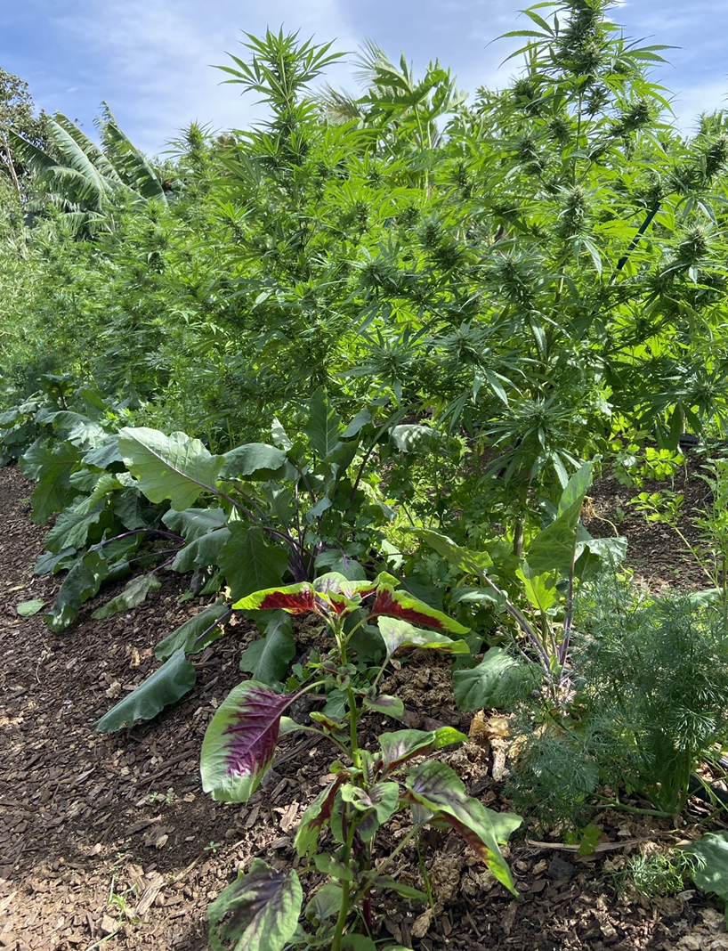
Activities
One of the strongest if not strongest origin labeling bills for Hawaii agricultural products
Planned:
In-person 2-day talk story
Platform for Hawaii farmer grown hemp products – cut through the noise so residents and Hawaii businesses know what is a Hawaii grown product
PSAs on various sectors of hemp and value in moving Hawaii towards greater sustainability

Slide 6

Let us know how we can better serve the hemp industry, especially farmers!
info@hawaiihempfarmersassociation.org

Slide 7
FACTS
Farmers have been growing and processing hemp into CBD oil on-farm for 5 years with no incident. Proposed state rules and existing rules make Hawaii farmers non-competitive.
Best public safety protection is testing of CBD products sold to public (in addition to testing of crops), which Hawaii farmers do. This ensures public knows CBD concentrations and that products have less than the 0.3% THC as required per law.
Hawaii hemp farmers are required to test their crops per USDA to ensure compliance, in addition to product testing.

