Slide 1
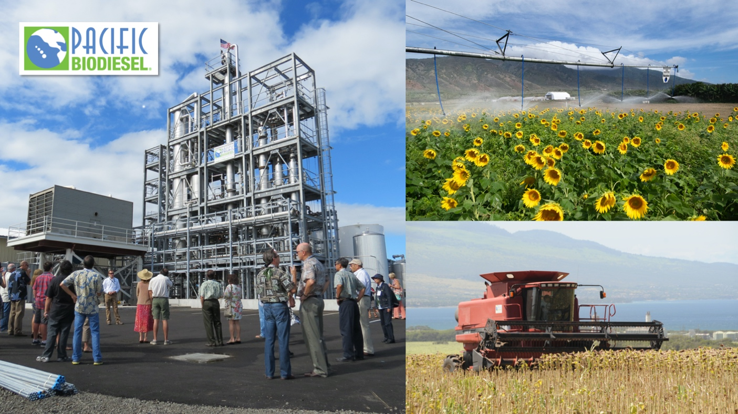
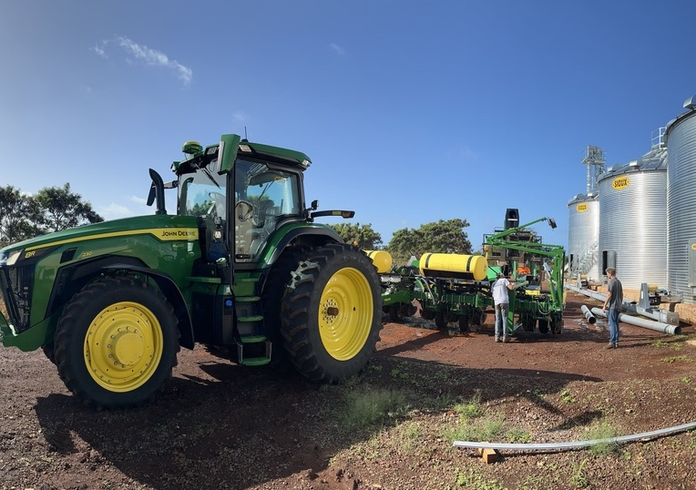
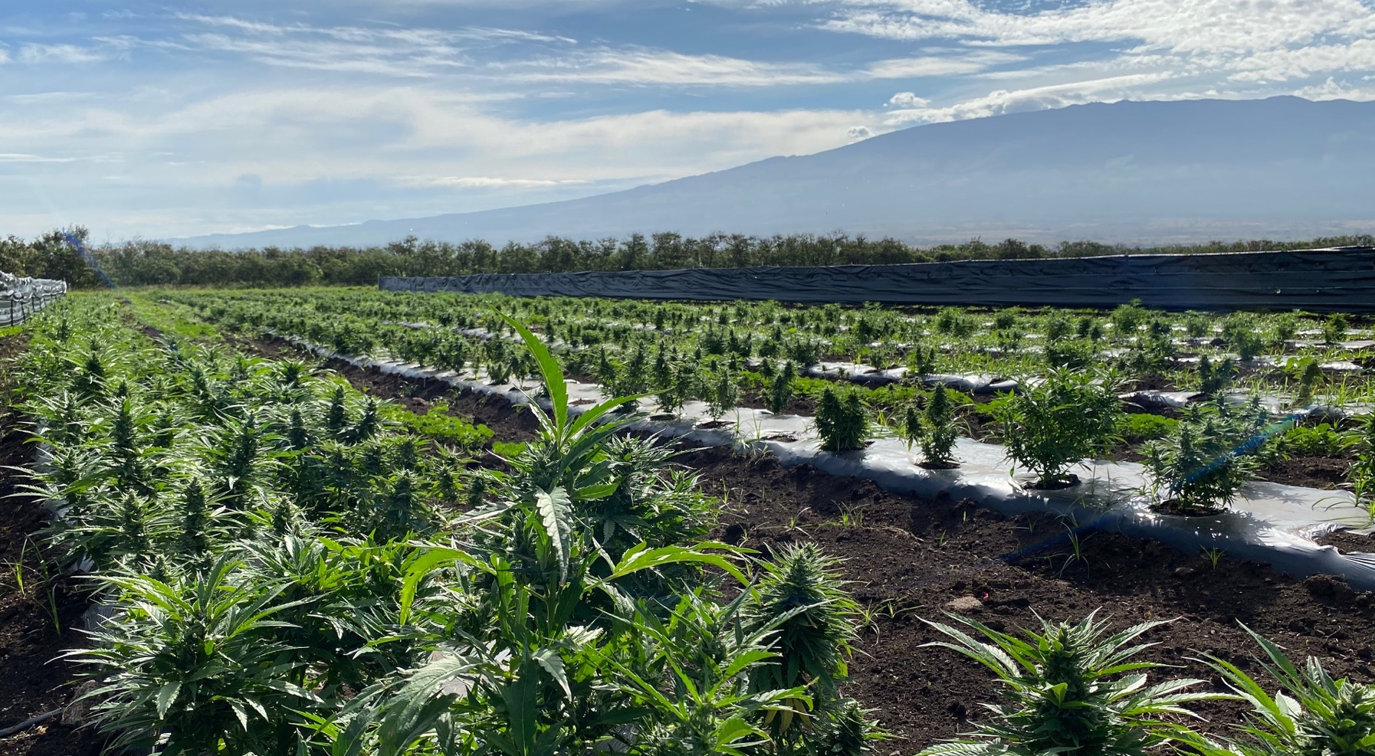

THE HEMP POTENTIAL:
Community-Based Biodiesel to
Grow Hawaii’s Circular-Economy
Presented by:
Bob King
Founder & President
July 24, 2024

Slide 2
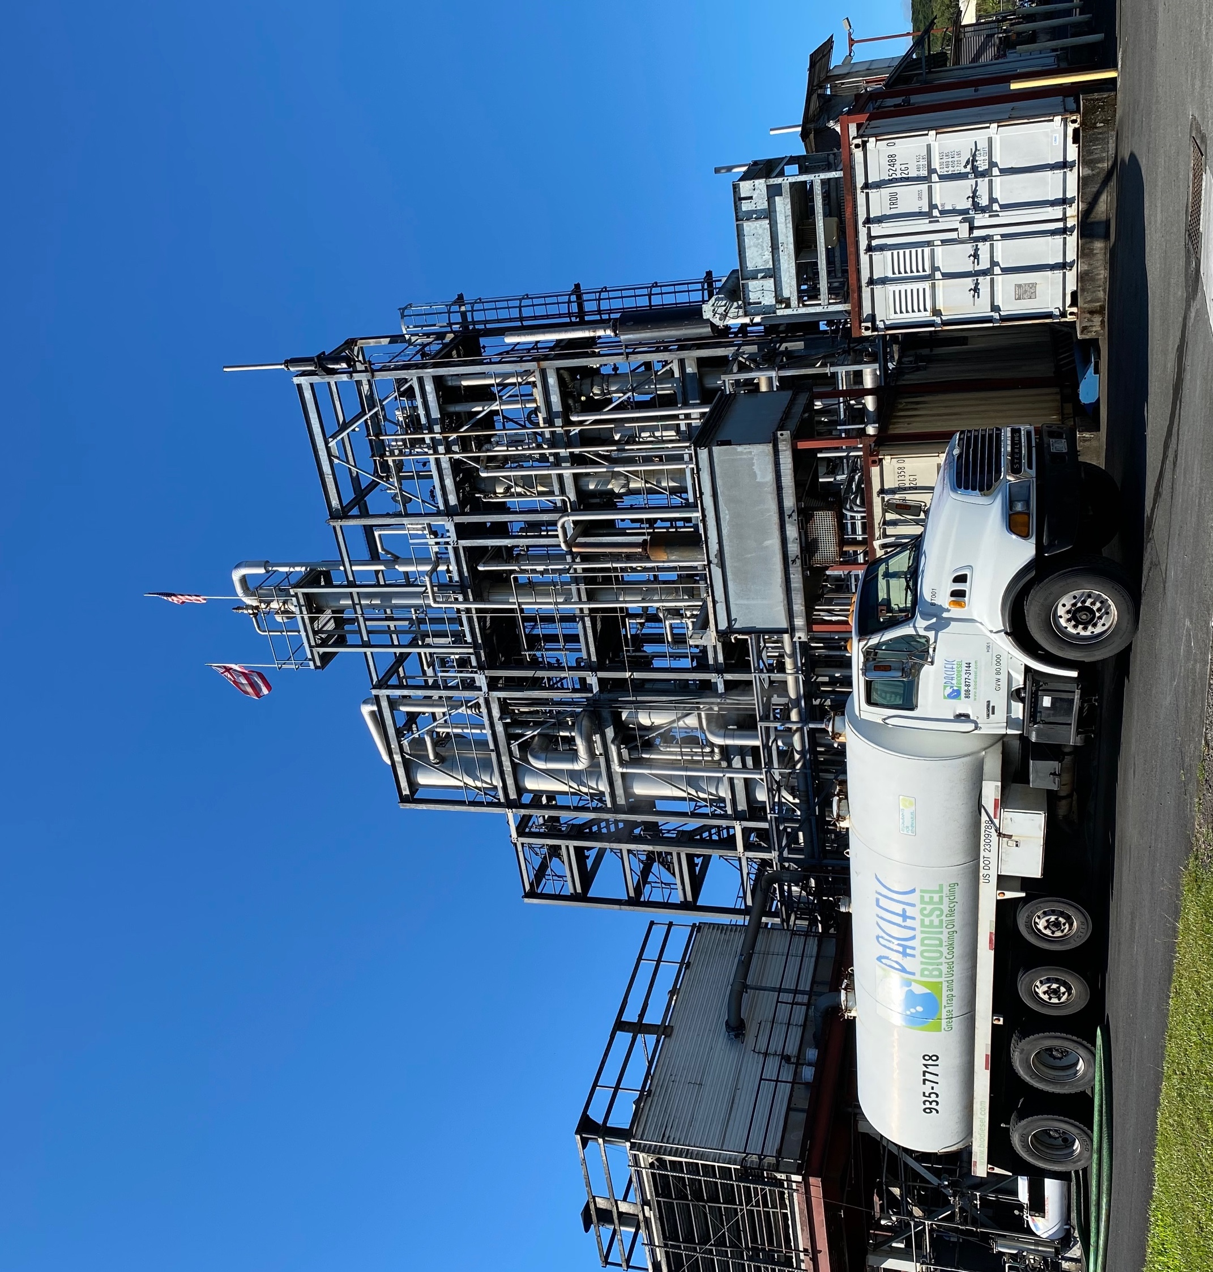
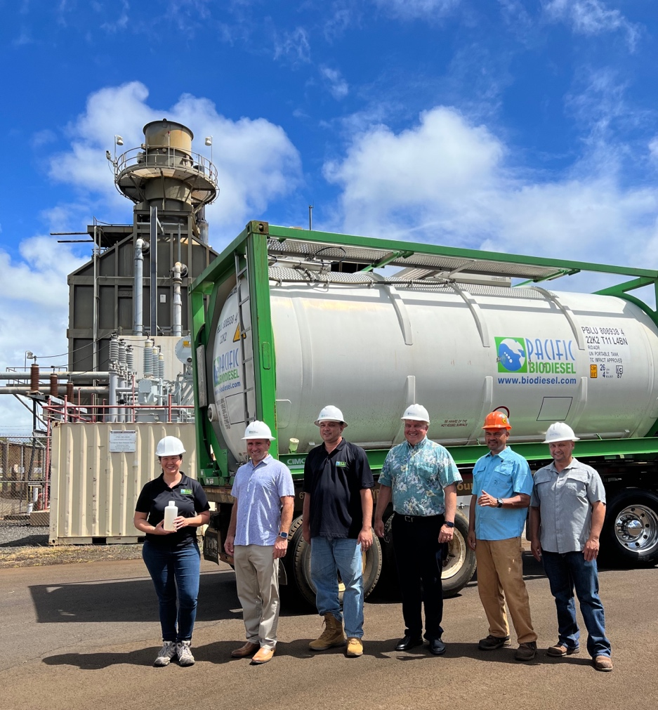

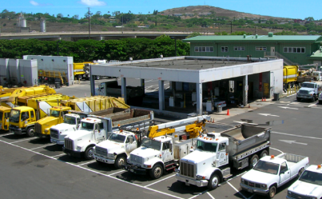
Biodiesel Made in Hawaii, for Hawaii

Slide 3
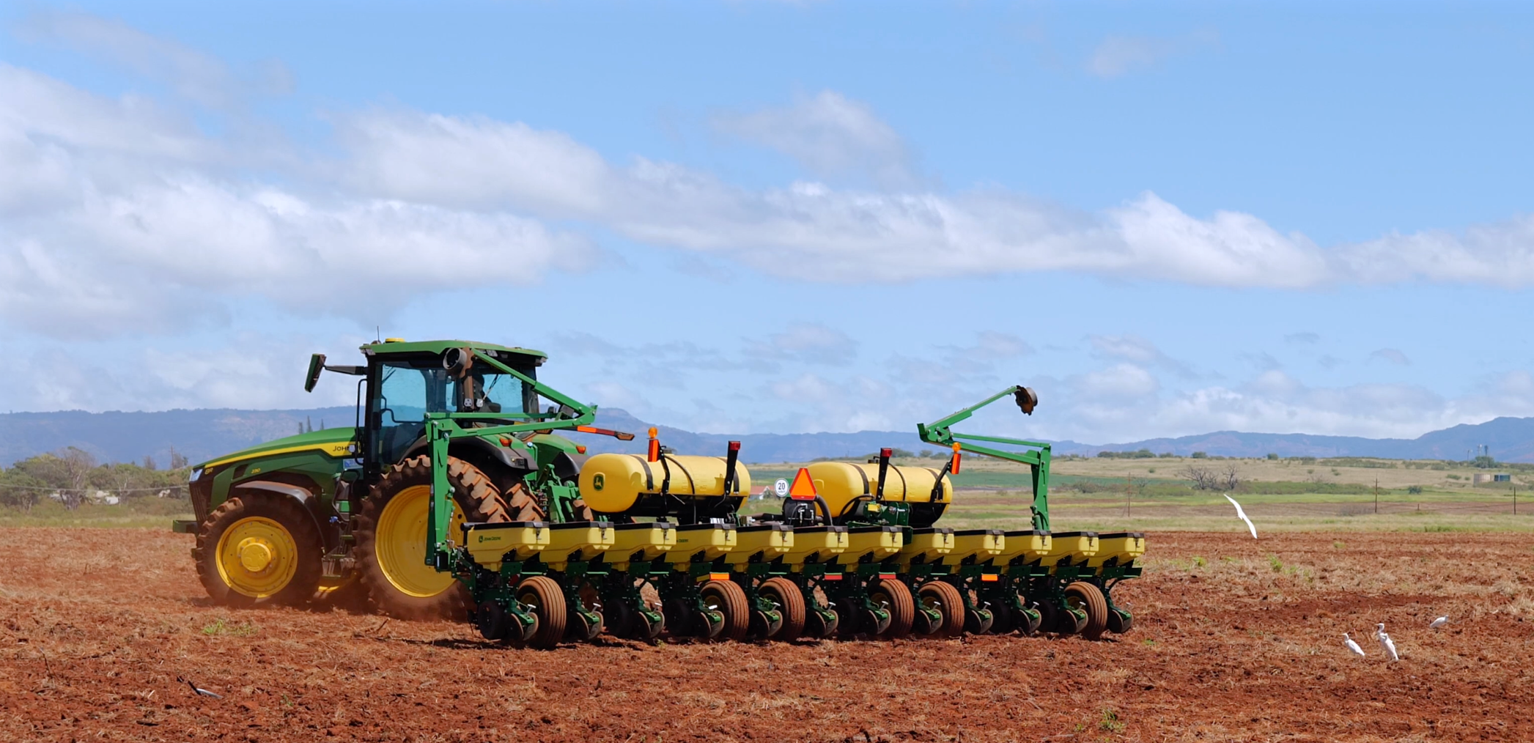
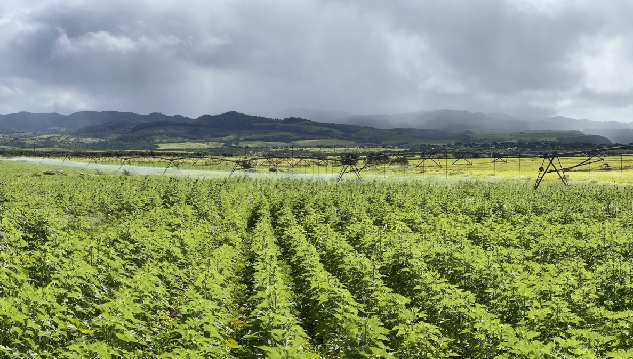
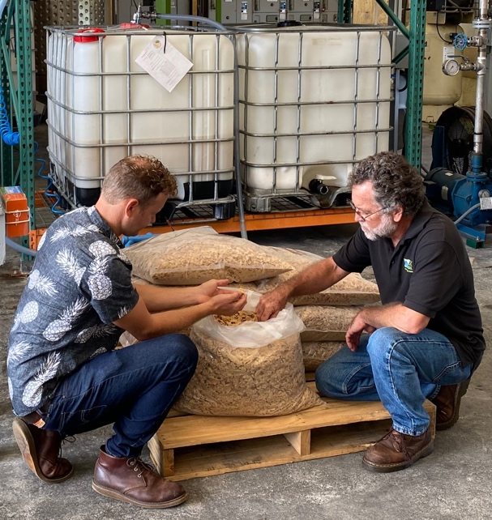
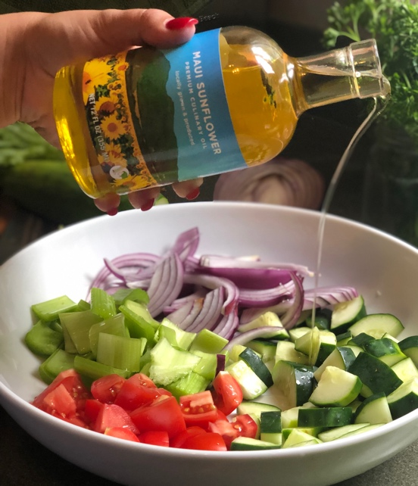
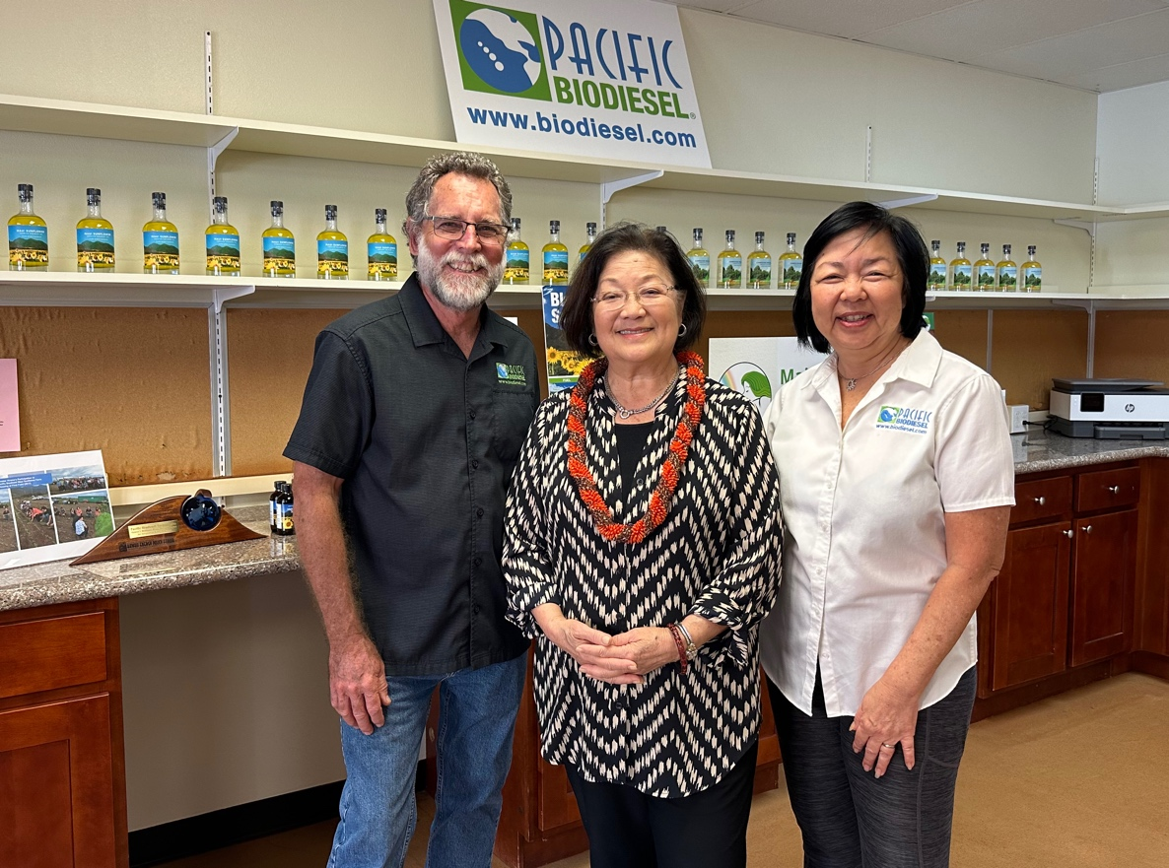
Above ground pivot irrigation for LOCAL food crops
Rice, potatoes, wheat, etc.
Culinary Oils: sunflower, madadamia + safflower, canola, hemp seed
2024 Expansion to Kauaʻi
A Regenerative Agriculture & Renewable Energy zero-waste model for “food first, then fuel”
USACE Hawaii ag-based biodiesel
1,000+ acre scale
Sunflowers & other oilseed cover crops
Culinary Oils + Meal for local Livestock Feed

Slide 4
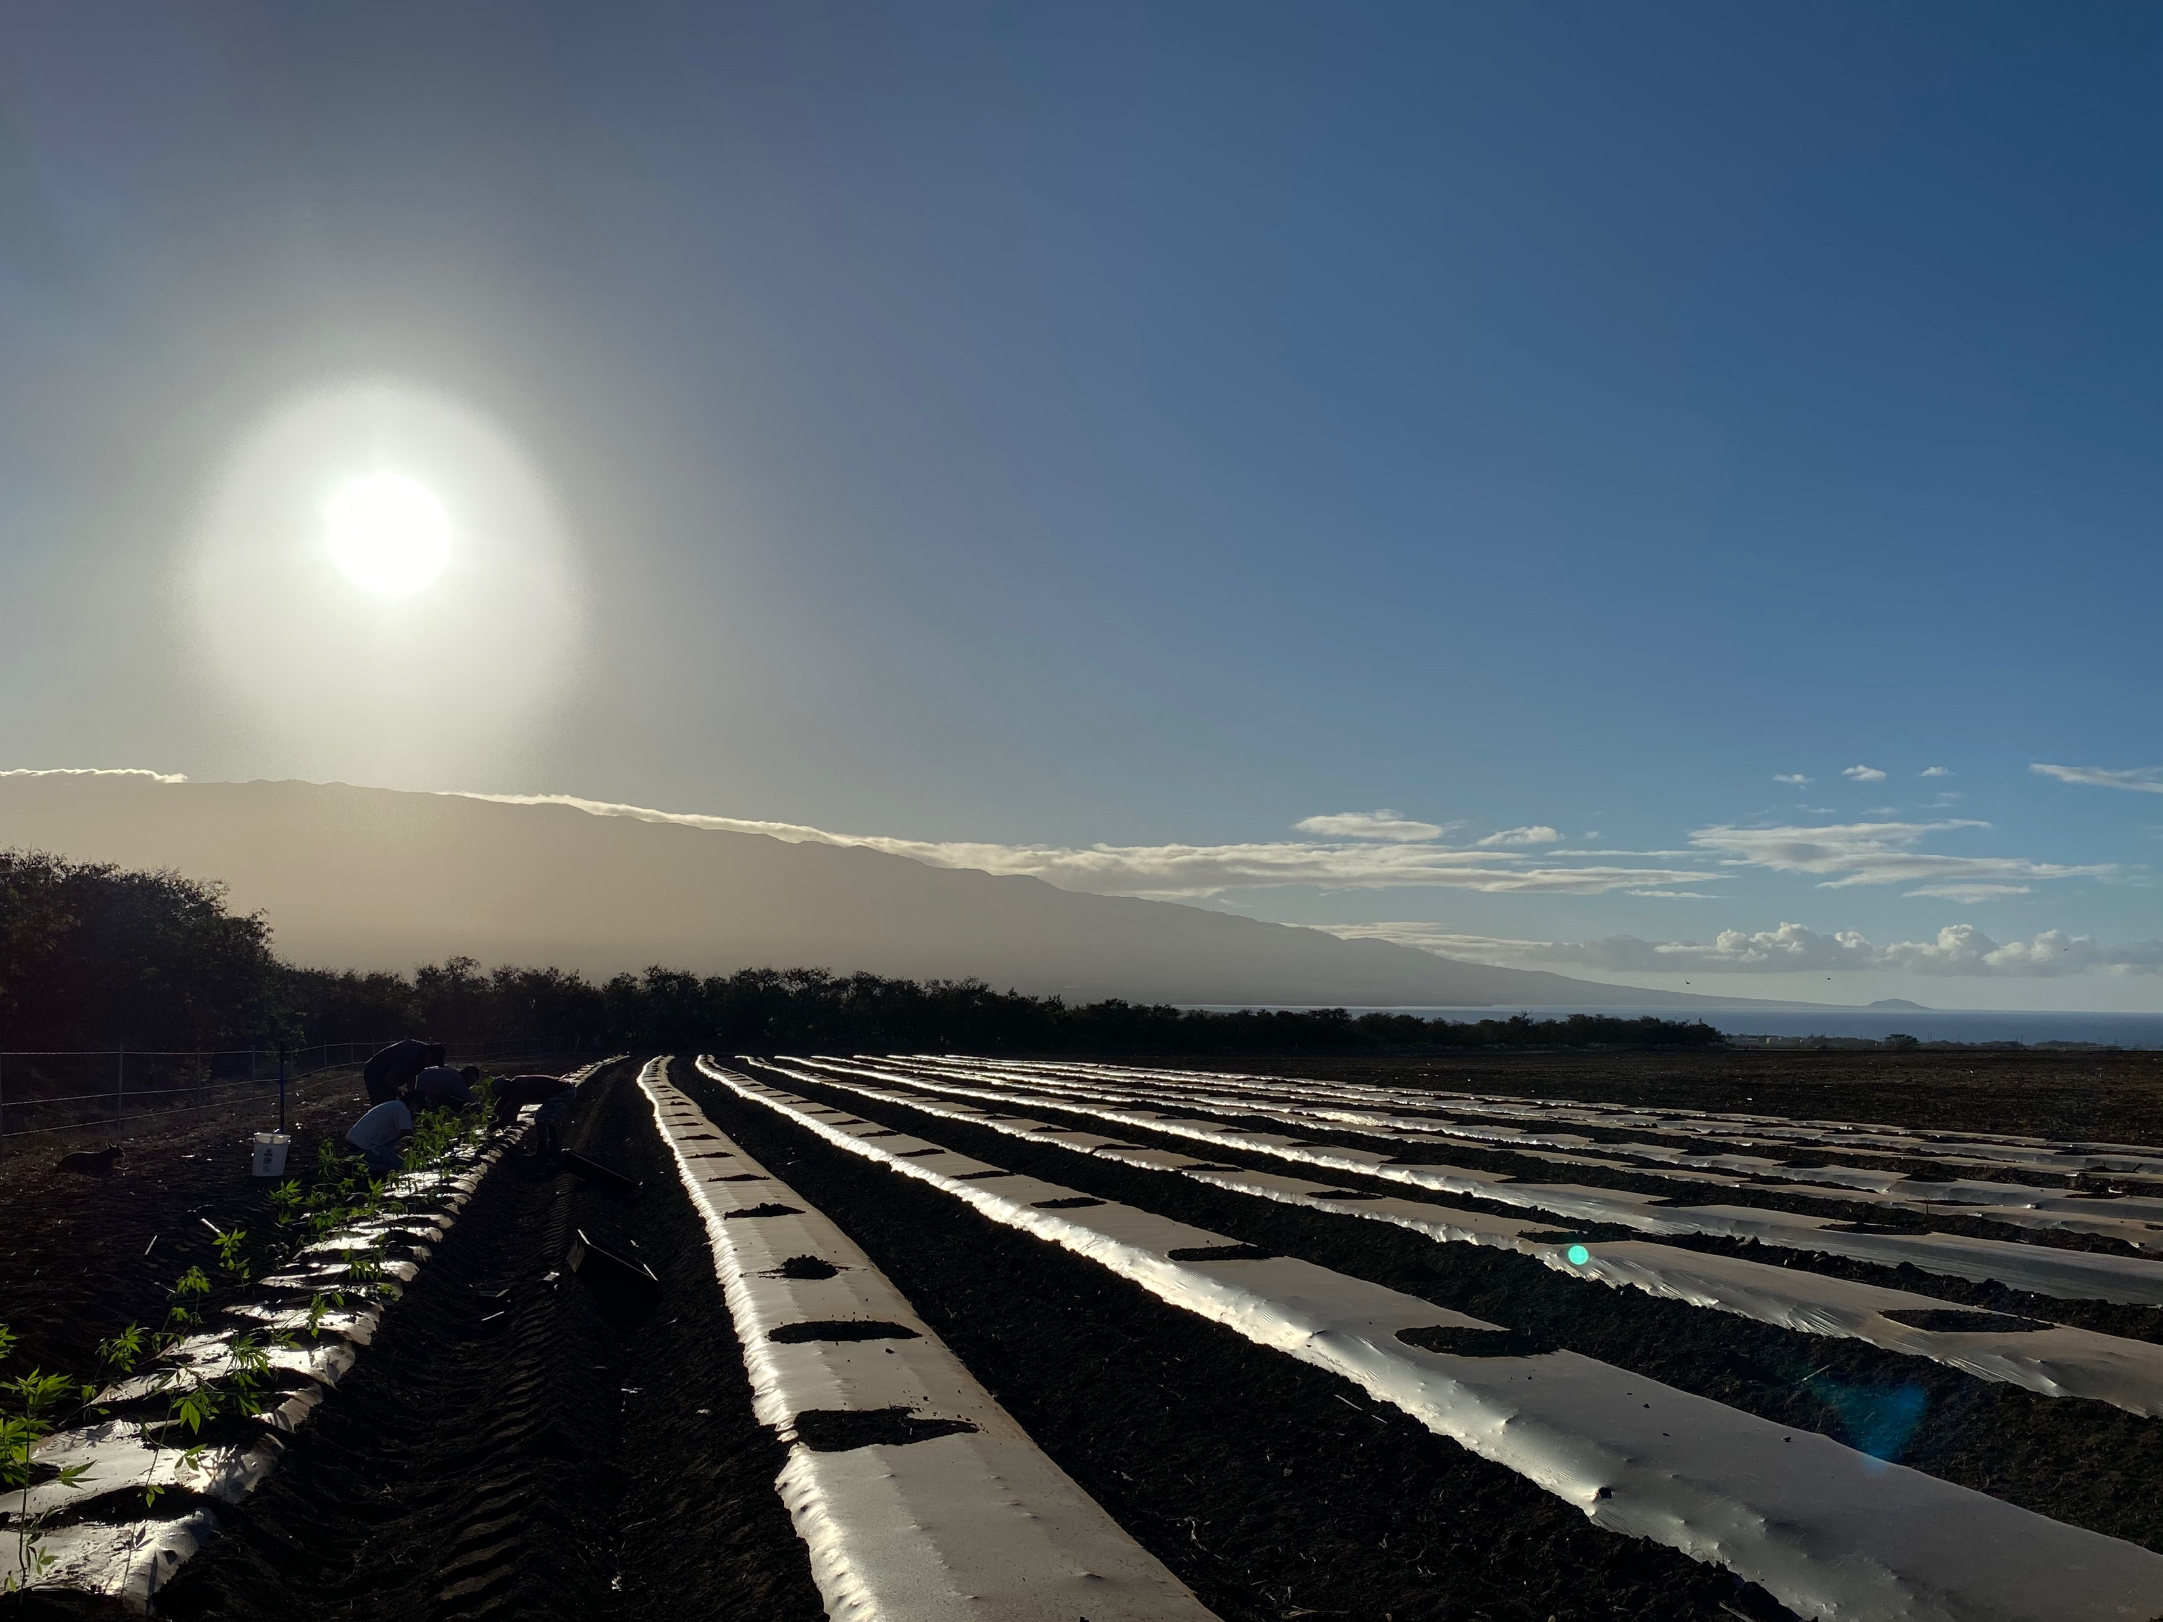
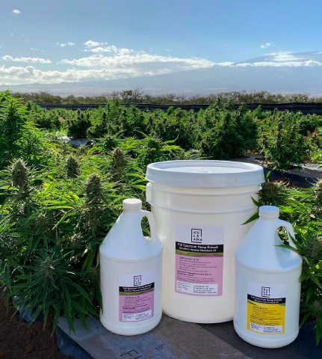
Hemp in Hawaii?
Challenges from the Beginning…
  Lack of State urgency and support
  Limited access to traditional capital
  Lack of clarity in government regulations
  Market confusion

Slide 5
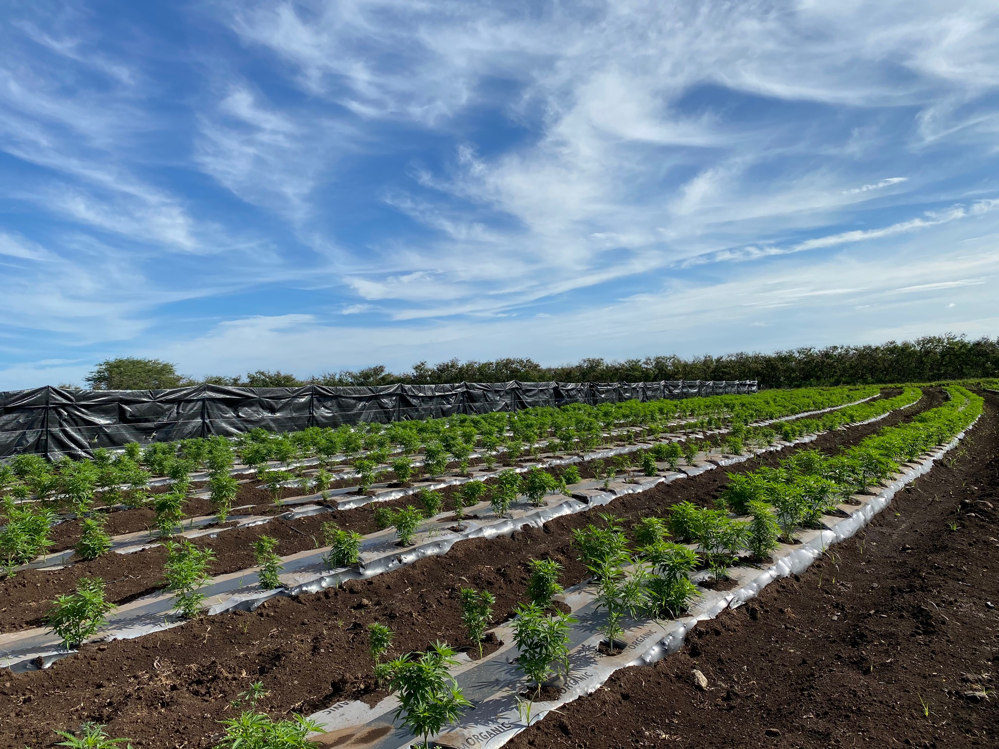
Mahalo!
Biodiesel.com
@pacificbiodiesel
@maidenhawaiinaturals

